Slide 1
NP-Hard
so how do we solve such puzzles?

Slide 2

A Travelling Salesman...
By now, I hope you know this problem really well… but in case you don’t...
A salesman has to visit n cities that are all connected by roads of varying distances. The salesman wants to find the optimum route that will allow them to visit every city only once and return back to the starting city.

Slide 3
A Travelling Salesman...
(Under-statement)
This problem is known to be a difficult one to solve.
A brute force approach becomes intractable very quickly as the number of cities increases.
So what are all those poor salespeople going to do?
Statement
difficult to manage

Slide 4

A Travelling Salesman...
Travelling Salespeople still have to travel and so still need to find the optimum routes along which to travel… or, at least, routes which are somewhat close to being optimal.
That’s something that we might be able to do!

Slide 5

Approach 1 : Random Guessing
Ok… so this one obviously isn’t the best approach to use but it might work. Randomly generating routes and checking their length whilst storing the shortest ones might get us a solution that is close to optimal…
Surely we can do better?

Slide 6
Approach 2 : Iterative Improvement
So using MSTs is a definite improvement and gives a pretty good solution. But let’s look at yet another way of improving it even further...
We can try changing small bits of our solutions one at a time to try and see if we can improve it further. Let’s try it.
(The next example applies the a 2-opt swapping algorithm)

Slide 7
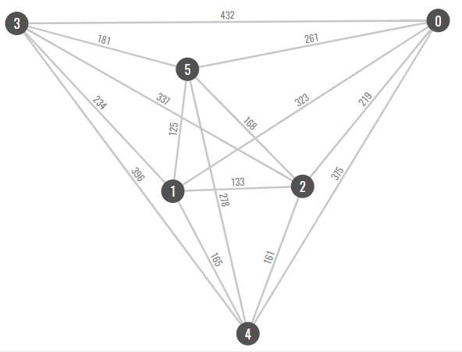
Route: 0,4,3,5,1,2,0
Path cost = 1429

Slide 8
Select a random sub path
Route: 0,4,3,5,1,2,0
Path cost = 1429

Slide 9
Select a random sub path
Route: 0,4,3,5,1,2,0
Path cost = 1429

Slide 10
Reverse the order
Route: 0,4,1,5,3,2,0

Slide 11
Check the new cost
Route: 0,4,1,5,3,2,0
Path cost = 1402

Slide 12
Check the new cost
Route: 0,4,1,5,3,2,0
Path cost = 1402
Better than previous, so keep it!
(If it wasn’t better, don’t keep it and try again with another random sub-path.)

Slide 13
Route: 0,4,1,5,3,2,0
Path cost = 1402

Slide 14
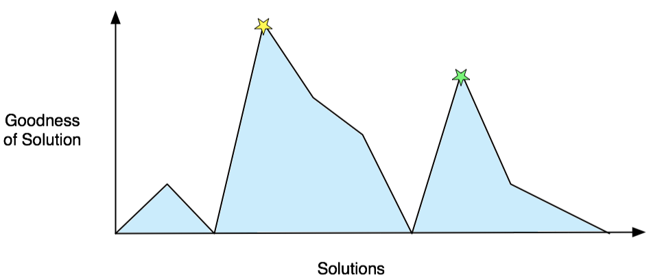
Approach 3 : Simulated Annealing
Of course, this is tedious and could ultimately get stuck because of an early choice which is not actually part of the optimum solution but is difficult to get rid of.
Simulated annealing attempts to help avoid this

Slide 15
Approach 3 : Simulated Annealing
Actual annealing in metals (swords, jewellery, etc):
heat
heat
cool (slowly)
Dislocations in grain lattice
Bonds break
Grains realign
Grains recrystalise

Slide 16
Approach 3 : Simulated Annealing
It works by moving towards better solutions when they present themselves but by also moving towards some bad solutions occasionally. It decides when to do this by using a random value and an “acceptance probability”. As the algorithm runs, the chance of it accepting a worse solution decreases but there is always the chance and this allows opportunity to get to a better solution (or another peak on that graph).

Slide 17
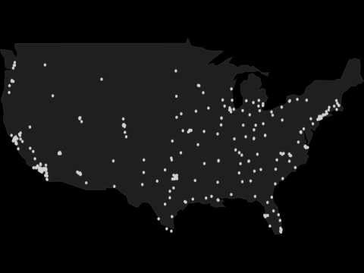

Slide 18
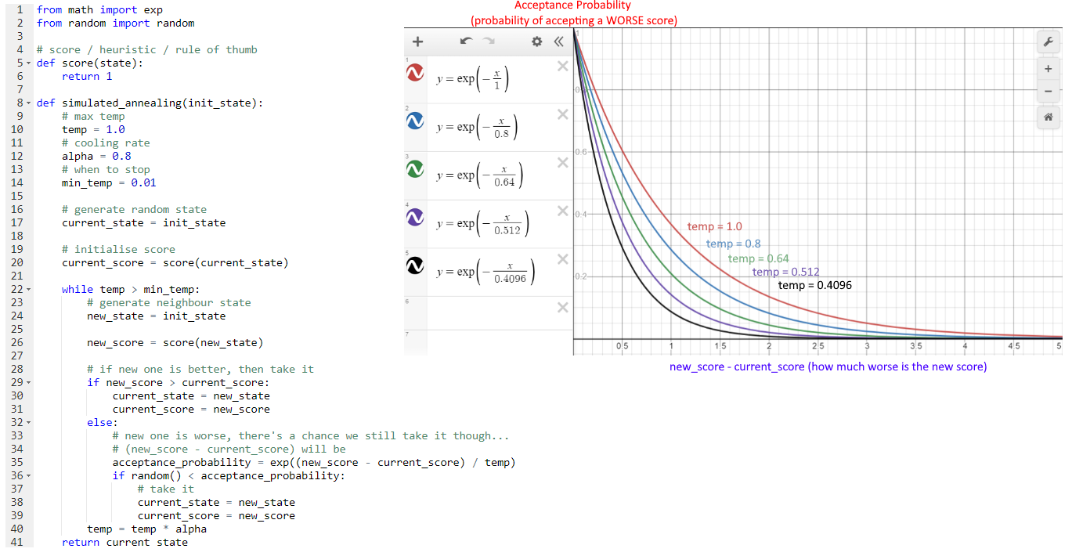

Slide 19
Starting temperature::
Ending Temperature:
Cooling factor (multiplier)

Slide 20
Generate Initial State:
Generate Neighbour State:
Scoring::
a floating point value between 0, 1.0 inclusive.
1.0 is a perfect score.

Slide 21
Acceptance Probability function:
e(new score – current score) / temp
Randomly generate a float between 0.0 and 1.0 inclusive
If this random number is less than the acceptance probability, then we take the worse answer

Slide 22
Acceptance Probability function:
e(new score – current score) / temp
The lower the temp, the lower the probability
The higher the difference in scores, the lower the probability

Slide 23
Simulated Annealing For TSP (Decision)
Is there a route that is 1253km long?
Generate Initial State:
Randomise a list of nodes (random path)
Generate Neighbour State:
Use 2-opt method as outlined before
Select 2 random nodes in the path
Reverse all nodes on path between 2 nodes
Scoring:
Score = 1 – ((path cost – decision cost) / decision cost)

Slide 24
Simulated Annealing For Graph Colouring (Decision)
Can the graph be coloured using 4 colours?
Generate Initial State:
Randomly colour graph using decision number of colours
Generate Neighbour State:
Randomly pick ‘n’ nodes and change their colours
Scoring:
Number of validly coloured edges / Number of total edges

Slide 25
Simulated Annealing For Knapsack (Decision)
Can we fit $250 worth of items in the knapsack?
Generate Initial State:
Randomly populate the knapsack up until capacity
Generate Neighbour State:
Randomly swap an item in the backpack with one not currently selected, checking that capacity is not exceeded.
Scoring:
Score = 1 – ((total value – decision value) / decision value)

Slide 26
Limitations of Randomised approaches
Can be inefficient as candidate solutions are generated at random and tested
Solutions can vary drastically from one execution to the next
Appropriate heuristics, if available can be applied to select candidates
E.g. in the knapsack problem, instead of picking another item at random, try selecting the one with the highest value/weight ratio
HOWEVER, this can also lead to a local maxima

Slide 27

Limitations of Meta-Heuristic approaches
Simulated Annealing still may not produce an optimal solution
While simulated annealing provides an opportunity to break out of local maxima, it still doesn’t guarantee this
The cost function can be expensive to compute, reducing the efficiency of the algorithm
Avoided the first local maxima but incorrectly identifies this one as the global maxima

Slide 28
Mini-Max
Remember Mini-Max?
On which of the following games would Mini-Max be an appropriate approach to try and win the game?
Chess Backgammon Scrabble Checkers Tic-Tac-Toe Monopoly Cards against Humanity Battleship

Slide 29
Mini-Max
Deterministic Vs Chance
Perfect Information Vs Imperfect Information
Mini-max is only appropriate when we have perfect information and the game is deterministic
Chess Backgammon Scrabble Checkers Tic-Tac-Toe Monopoly Cards against Humanity Battleship

